Slide 1
Computer Science
CODING
Notes:
I’m super excited to share a fun activity with you today! We’re going to be talking about computer science, but more specifically, we’re going to be talking about CODING! Coding is like a special language that a computer can understand. Codes are used by programmers who write the instructions for computers to follow. Think of it like this, if someone asked you how to find the student restrooms, you would give them step-by-step instructions. Coding is the same idea, but it’s done specifically for computers. Today, you’ll practice writing codes, and you may even have a chance to write a whole program!

Slide 2
Learning Target
I can use an algorithm to move an object in a virtual world using block coding so that I can run the program and complete the challenge.
I’ll know I have it when I can write the code to complete a given puzzle.

Slide 3
Introduction to Coding
Notes:
Let’s watch a quick video that will explain coding a little more…
[show video]
So, as you saw in the video, coding is involved in many kinds of technology, not just computers. Programs are written for things like traffic lights, cash registers, and even your electronic marquee at the front of the school!

Slide 4
Anyone can code!
Notes:
There’s something exciting happening around the world relating to computer programming, and it’s called Hour of Code. Let’s take a look at what some people have to say about Hour of Code… you might just recognize some of them!

Slide 5
Vocabulary
Notes:
Computer programming starts with something called an algorithm. The word “algorithm” may sound like something complicated, but really it’s just a LIST OF STEPS that someone or something can follow to achieve a result. A program is an ALGORITHM (or list of steps) that has been coded into something that can be run by a machine.
Who can tell me what an algorithm is in their own words?

Slide 6
Vocabulary
Notes:
A program is an ALGORITHM (or list of steps) that has been coded into something that can be run by a machine.
Who can tell me what a program is in their own words?

Slide 7
Events
Notes:
In our first activity, we’re going to practice writing simple algorithms. You will be using your arrow papers to respond with one of these four EVENTS. (An event is an action or a step.)
Take a look at the four possible events: move one square right; move one square left; move one square up; and move one square down. Notice there are no diagonals. These four steps are the only possible events during our activity.
Are there any questions about which directions we can use for our algorithm?

Slide 8
Which way should the Flurb step to get to the gold?
Notes:
Take a look at this grid. The grid displays squares, and each square represents on step. For this activity, we want to use the smallest number of steps to get the flurb to the pot of gold. Use your fingers to show me how many steps the flurb needs to make to get to the pot of gold? Good. The flurb can reach the pot of gold in one step. Now, use your arrow paper to show me which direction the flurb needs to go. [Students hold up arrows showing the direction the Flurb needs to go.]

Slide 9
Which way should the Flurb step to get to the gold?
Notes:
Good. The flurb needs to move one step to the right. Let’s try another one…

Slide 10
Which way should the Flurb step to get to the gold?
Notes:
Use your fingers to show me how many steps the flurb needs to make to get to the pot of gold? Good. The flurb can reach the pot of gold in one step. Now, use your arrow paper to show me which direction the flurb needs to go. [Students hold up arrows showing the direction the Flurb needs to go.]

Slide 11
Which way should the Flurb step to get to the gold?
Notes:
Awesome. The flurb needs to move one step to the left. Let’s try one more…

Slide 12
Which way should the Flurb step to get to the gold?
Notes:
Use your fingers to show me how many steps the flurb needs to make to get to the pot of gold? Good. The flurb can reach the pot of gold in one step. Now, use your arrow paper to show me which direction the flurb needs to go. [Students hold up arrows showing the direction the Flurb needs to go.]

Slide 13
Which way should the Flurb step to get to the gold?
Notes:
I think you have it! The flurb needs to move one space up to reach the gold! Nice work!

Slide 14
Controller and Walking Machine
REVIEW
List of steps = algorithm
Special codes for an algorithm (list of steps) = program
Once a program is written, a machine can complete the task.
Move (right) one step.
Notes:
When we wrote our algorithm to get the flurb to the pot of gold, we used arrows as our special codes. We said, “Move right one step.”

Slide 15
Let’s create an algorithm together!
Write an algorithm using Remember, our goal is to use the least number of steps possible.
Notes:
Let’s practice writing a longer algorithm together. I want you to use your paper arrows again as I ask you which direction we should step to get to the smiley face. Remember, our goal for this activity is to use the least number of steps possible. So show me the direction you think we should step. (Hint: There is more than one correct answer!) {Students will hold up arrow papers to suggest which direction is a possible move.] Super! The majority of you said we should step ____, so let’s make that the first step in our algorithm. We need to make another step. Show me the direction you think we should go in this step. (Remember, there is more than one correct answer!) {Students will hold up arrow papers to suggest which direction is a possible move.] Great! The majority of you said we should move ____. We’ll make that the second step in our algorithm. We need one more step to complete our algorithm. Show me the direction you think we should go in this step. (Remember, there is more than one correct answer!) {Students will hold up arrow papers to suggest which direction is a possible move.] You are amazing! Most of you chose to move ____, so we’ll make that our last step in our algorithm.

Slide 16
Let’s create an algorithm together!
Move 1 step ____.
Move _ step ____.
Move _ step ____.
Notes:
Let’s take a quick look at the final algorithm we wrote. [Teacher will fill in the blanks.]

Slide 17
Let’s write another algorithm that we can run as a program.
Notes:
Now that we’ve practiced writing an algorithm together, you’re going to try one on your own. This time, once everyone has written an algorithm, we’re going to run it as a program. So, I need a volunteer for someone to be our “walking machine.” This person will test the algorithm by actually walking the steps. If the algorithm is correct, they will reach the smiley face. Who would like to be the walking machine?
[walking machine will sit in a chair at the front of the class and face the rest of the students (not looking at the board).] Once the walking machine is seated, the teacher will go to the next slide .

Slide 18
Let’s write another algorithm that we can run as a program.
Write an algorithm using Remember, our goal is to use the least number of steps possible.
Notes:
Okay, Mr/Miss Walking Machine, no peeking! ☺
The rest of us our going to write an algorithm with the first step starting at the “start” square. If you finish writing your algorithm before everyone else is finished, try writing a different algorithm, using the same number of steps.
Teacher will play Move It song by clicking the icon on the upper left corner of the slide.

Slide 19
Let’s write another algorithm that we can run as a program.
Notes:
Okay, Walking Machine. Are you ready to test an algorithm? [Teacher will have the Walking Machine stand on the Start Square. Then the teacher will ask for another student’s algorithm. That student will stand and read one step at a time while the walking machine steps. After each step, the Controller will read another step. When all steps in the algorithm have been read, turn the paper over to see if the smiley face is there.

Slide 20
Puzzle Solving Recipe for Success
Notes:
Sometimes coding can be frustrating. These recipe cards will help you work through any problems you may have. And remember, we learn more when we work together, so it’s okay to ask a friend to help you solve any issues once you’ve tried it on your own. You have a copy of these recipes on the back of your algorithm sheet.

Slide 21
Moana Introduction
Notes:
I think you’re ready to try coding on the computer! We’re going to be using a website that has partnered with Disney to create some super-cool activities for people to learn how to code. But, before we get started, let’s watch a quick video that will explain exactly what you’ll be doing.

Slide 22
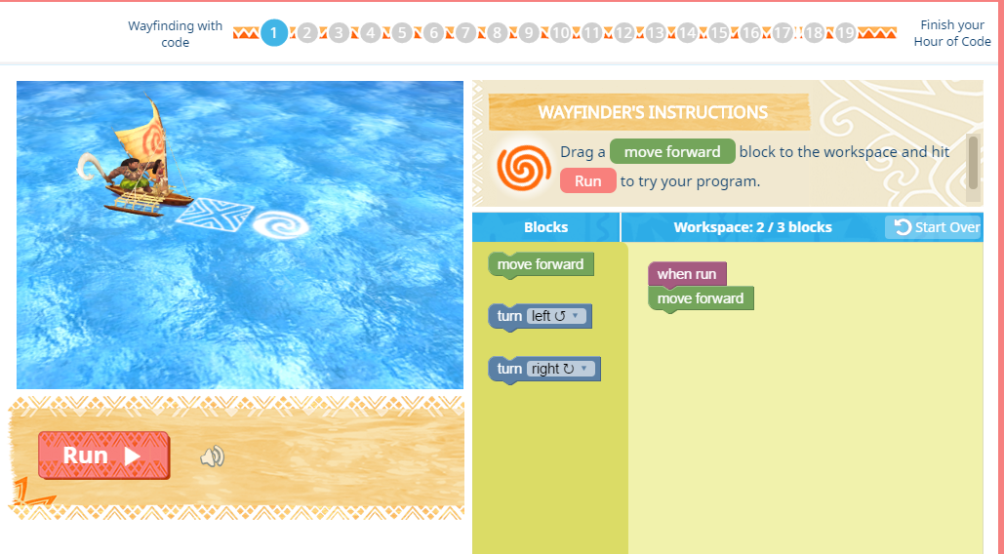
code.org/student
Notes:
Let’s put our new skills to the test! Since you now understand events and algorithms, it’s time to try coding! You’ll start with short, simple algorithms, and each puzzle with get a little more difficult. If you finish all the puzzles, you will have a chance to create your own program (game)!
The teacher will have students go to code.org/student, click on Start under Hour of Code.
[NOTE for Teachers: Each tutorial will give you a video overview of how to use the tutorial. Each tutorial also has multiple puzzles or levels that you must pass in order to advance to the next puzzle. Notes are included at the beginning of each puzzle and they should be carefully read before starting each puzzle.]

